Slide 1
CARGO MANAGEMENT SYSTEM

Slide 2
TABLE NAME: ADMIN
FIELD NAME | FIELD TYPE | SIZE | CONSTRAINT
admin_id | Int | 10 | Primary key
Name | Varchar | 25 | Not null
Email | Varchar | 25 | Not null
Phone | Int | 10 | Not null
Address | Varchar | 25 | Not null
Zip_code | Int | 6 | Not null
Username | Varchar | 25 | Not null
Password | Varchar | 12 | Not null

Slide 3
TABLE NAME: SHIP
FIELD NAME | FIELD TYPE | SIZE | CONSTRAINT
Ship Id | Int | 10 | Primary key
Vehicle_number | Varchar | 12 | Not null
Vehicle_type | Varchar | 15 | Not null
Vehicle_model | Varchar | 15 | Not null

Slide 4
TABLE NAME: ORDER
FIELD NAME | FIELD TYPE | SIZE | CONSTRAINT
Order id | Int | 10 | Primary key
Name | Varchar | 20 | Not null
Address | Varchar | 25 | Not null
Pickupdate | Date | 10 | Not null
Deliverydate | Date | 10 | Not null
Weight | Number | 25 | Not null
Packing_type | Varchar | 25 | Not null
Company_name | Varchar | 20 | Not null
Company_address | Varchar | 25 | Not null
Mobile_number | Number | 12 | Not null
Picklocation | Varchar | 15 | Not null
Droplocation | Varchar | 15 | Not null
Customer_id | Int | 10 | Foreign key

Slide 5
TABLE NAME: CUSTOMER
FIELD NAME | FIELD TYPE | SIZE | CONSTRAINT
Customer id | Int | 10 | Primary key
Name | Varchar | 25 | Not null
Email | Varchar | 25 | Not null
Phone | Int | 10 | Not null
Address | Varchar | 25 | Not null
Zip_code | Int | 6 | Not null

Slide 6
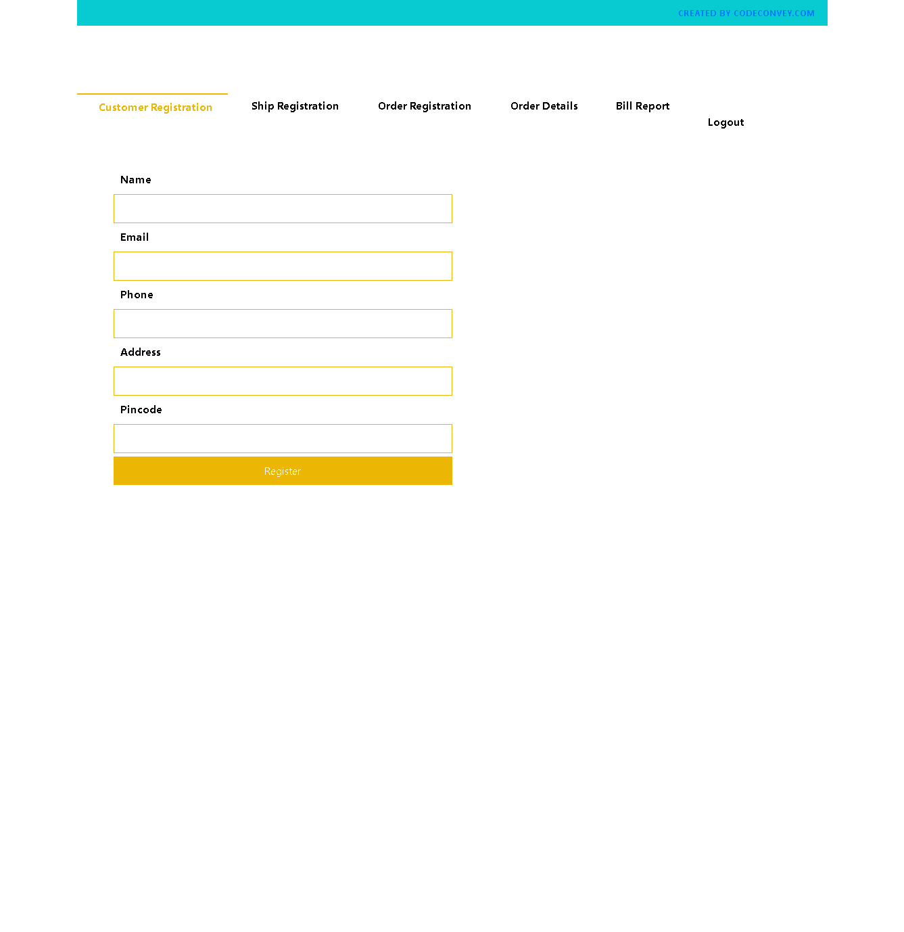

Slide 7
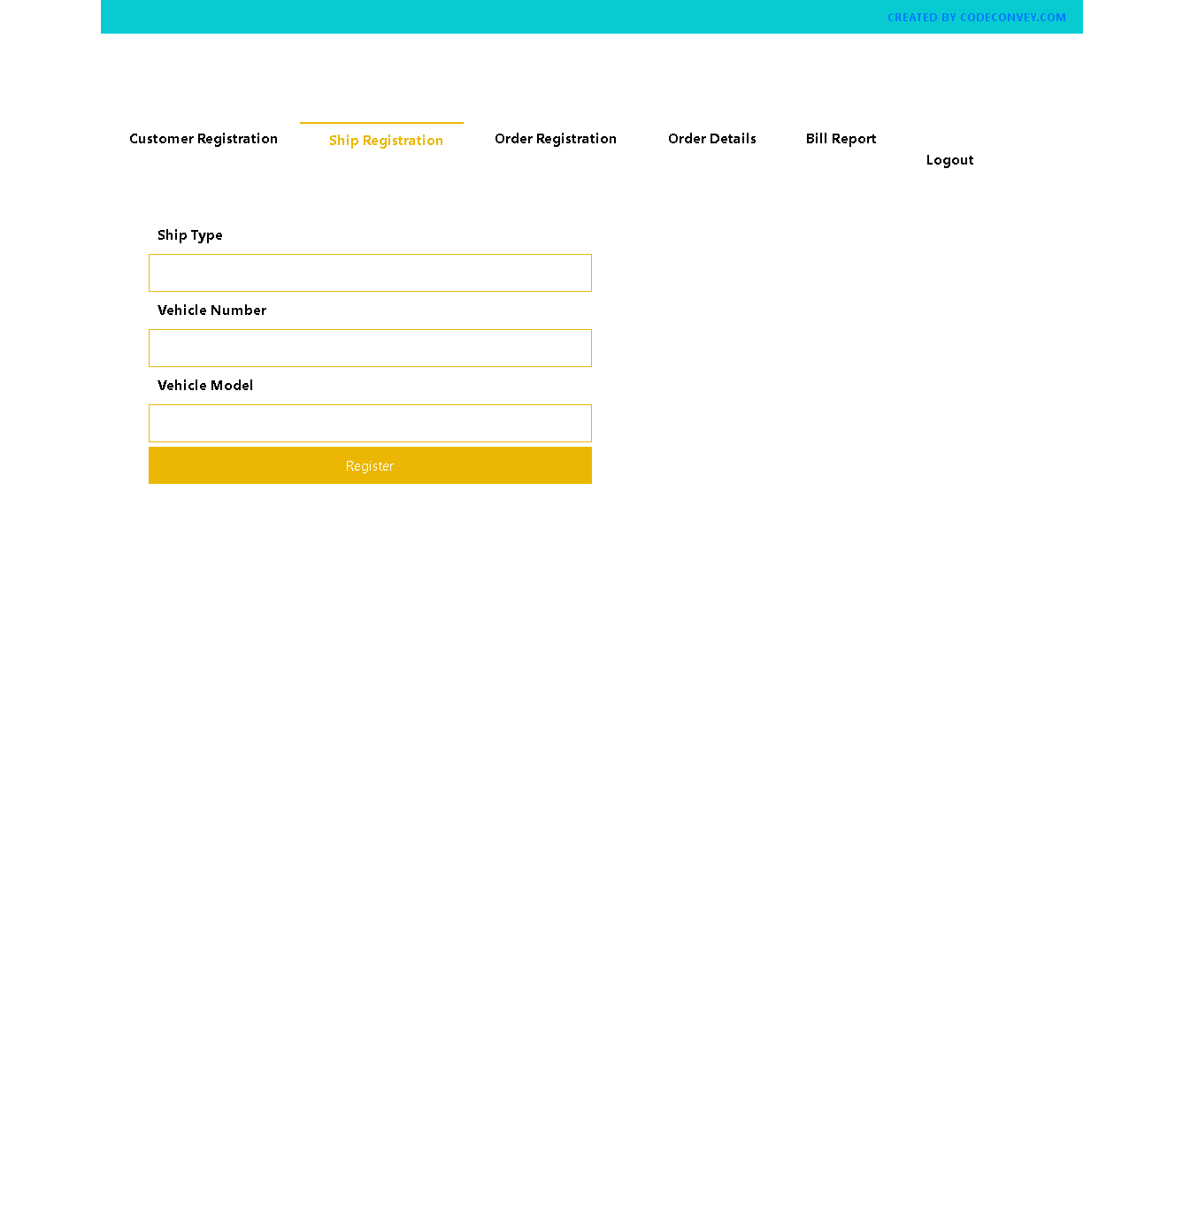

Slide 8
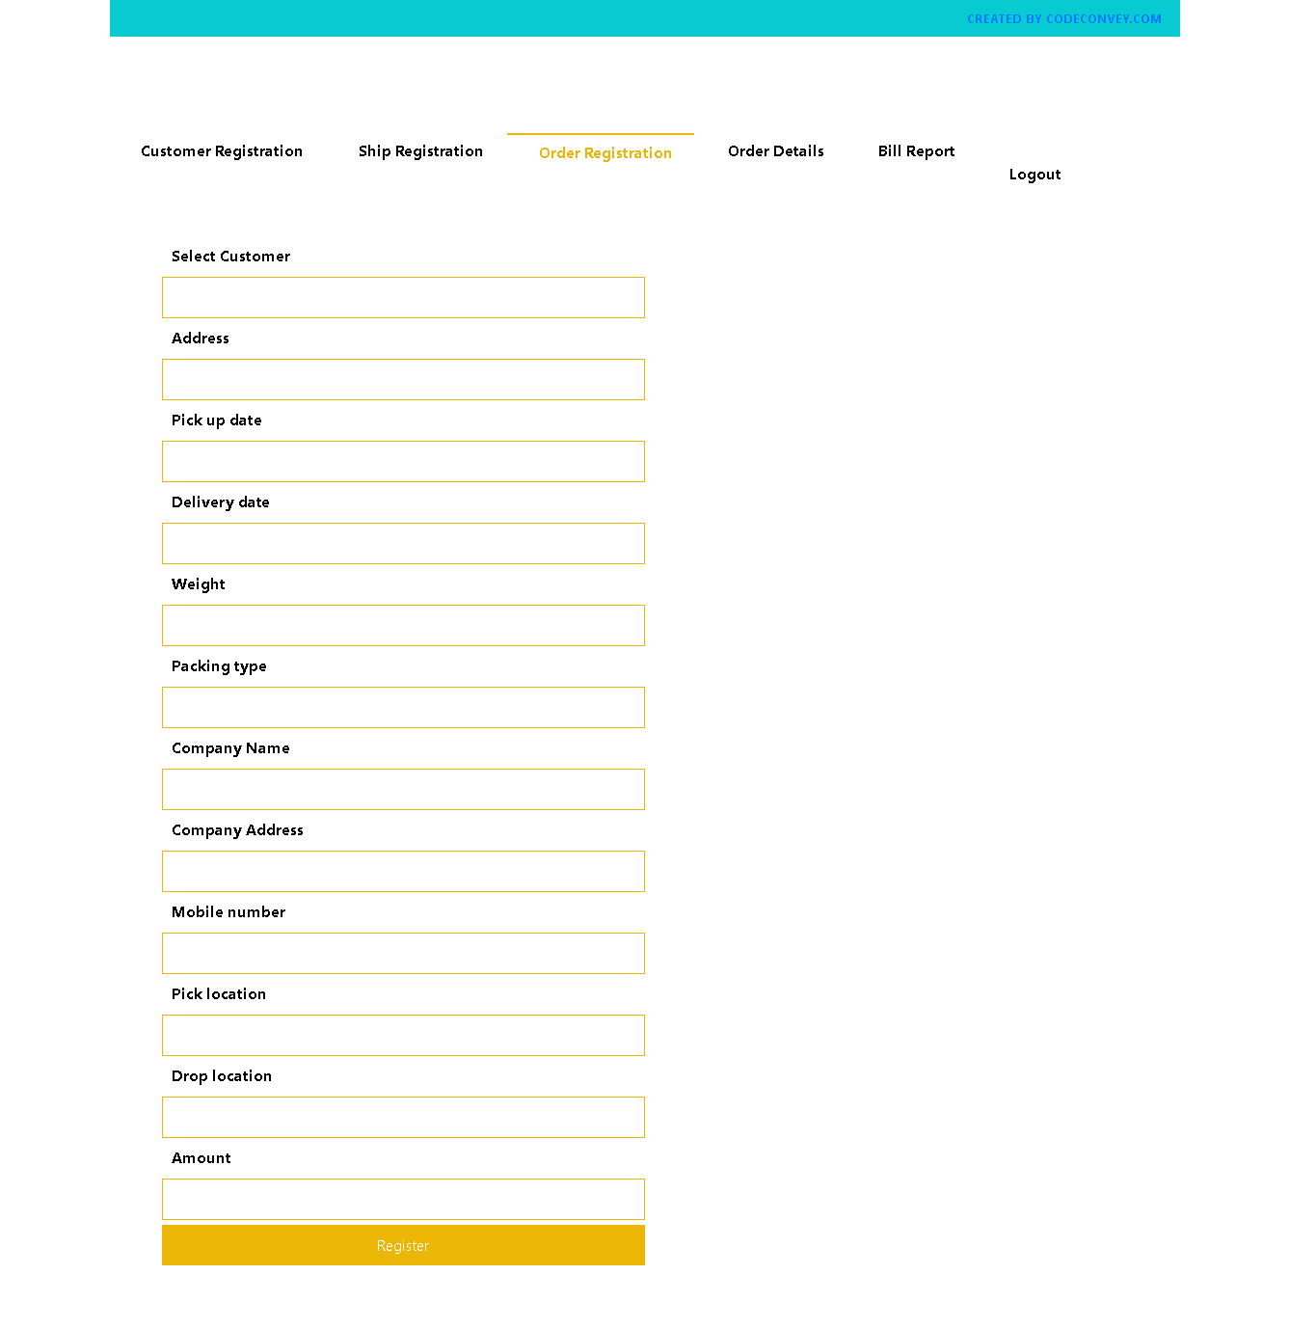

Slide 9
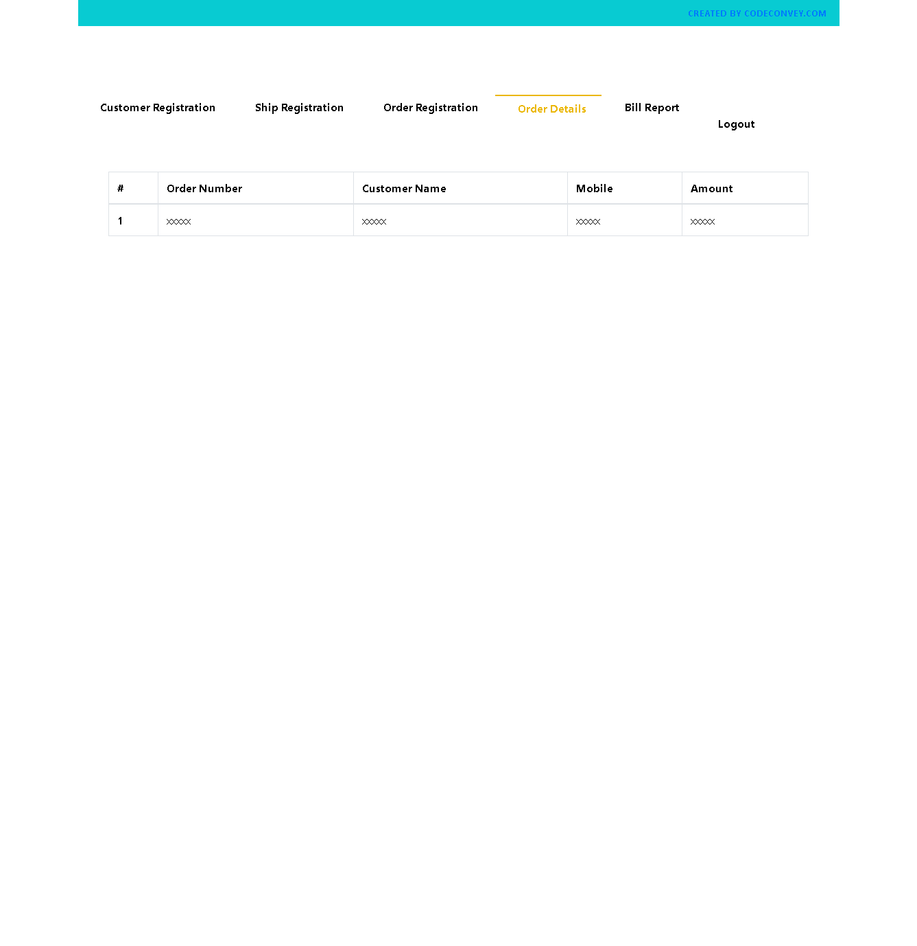

Slide 10
Thank You

